Slide 1



THIRD REVIEW
Department of Computer Science and Engineering
22CSP72 PROJECT WORK II
Deep Learning-Based Multimodal Classification of Drug-Resistant and Drug-Sensitive Tuberculosis Using Chest X-Rays and Genomic Information
Team Number : A22
Team Guide : Dr. K. Venu
Team Members :
Abinandhana S G (23CSR008)
Anbuselvam N (23CSR018)
Gobika R (23CSR062)

Slide 2
PROBLEM STATEMENT
Existing Chest X-ray (CXR) methods do not specifically focus on the lung region, so irrelevant areas of the X-ray may affect the prediction.
Existing deep-learning approaches have limited Explainable AI capabilities, making it difficult to understand the regions influencing the Chest X-ray prediction and the contribution of Chest X-ray and genomic information to the final decision.
Existing approaches do not provide a unified diagnostic report showing the predictions and confidence scores of the Chest X-ray, genomic, and multimodal models

Slide 3
OBJECTIVES
To isolate the lung region from Chest X-ray images for focused feature extraction.
To use separate deep-learning models, CoAtNet-0 for Chest X-ray data and a Transformer for genomic data, to classify Drug-Resistant Tuberculosis (DR-TB) and Drug-Sensitive Tuberculosis(DR-TS).
To combine Chest X-ray and genomic features using multimodal late fusion for Drug-Resistant Tuberculosis and Drug-Sensitive Tuberculosis classification.
To provide Explainable AI using Grad-CAM and modality-contribution analysis, along with prediction confidence for the Chest X-ray, genomic, and multimodal models.

Slide 4
LITERATURE SURVEY
S.No | Paper (Year) | Model Used | Performance | Limitations / Research Gap | Proposed Improvement
1 | Explainable AI for Drug-Resistant Tuberculosis Detection from Chest X-Rays (2026) | DEiT-B/16 Transformer, Raw Attention, Grad-CAM, LIME | Recall 82.8%, Precision 82.6%, F1 82.7%, AUC 0.800 | CXR only; no genomic information or multimodal fusion | CoAtNet-0 + Genomic Transformer + Late Fusion + Grad-CAM + Modality Contribution
2 | Combining Radiological and Genomic TB Portals Data for Drug Resistance Analysis (2023) | Random Forest | 92.4% accuracy for CXR + genomic data | No deep multimodal feature learning | CoAtNet-0 for CXR + Transformer for genomic features + Late Fusion
3 | TB-CXRNet (2024) | CheXNet + PCA + Stacking Classifiers | 87.48% accuracy for DR-TB vs DS-TB | CXR only; no genomic information; limited explainability | Lung-focused CXR + CoAtNet-0 + Genomic Transformer + Multimodal Explainability
4 | Generalization Challenges in Drug-Resistant Tuberculosis Detection from Chest X-rays (2022) | InceptionV3/CNN | AUC around 0.85 internally; around 0.65 on unseen data | Performance decreases on unseen datasets | Lung-focused preprocessing + multimodal CXR and genomic information
5 | AI-driven Drug Resistance Profiling in Tuberculosis Patients: A Transfer Learning Approach (2025) | ResNet50, DenseNet121, EfficientNet + Genomic Transformer + Attention-based Fusion | 91.2% accuracy, 89.4% sensitivity, 92.7% precision | Uses three modalities including clinical data; requires higher computational resources and external validation | Focus on CXR + genomic information using CoAtNet-0 and Transformer with late fusion

Slide 5
RESEARCH GAP
Existing DR-TB studies mainly focus on CXR analysis, while multimodal studies use CXR and genomic information in different ways. However, lung-focused CXR processing is not consistently used in these approaches.
Existing studies do not specifically combine lung-focused CoAtNet-0 CXR features with mutation-based genomic Transformer features for DR-TB and DS-TB classification.
The use of Explainable AI with multimodal predictions is still limited, particularly for providing Grad-CAM explanations, modality contribution, and confidence scores in a unified diagnostic report.

Slide 6
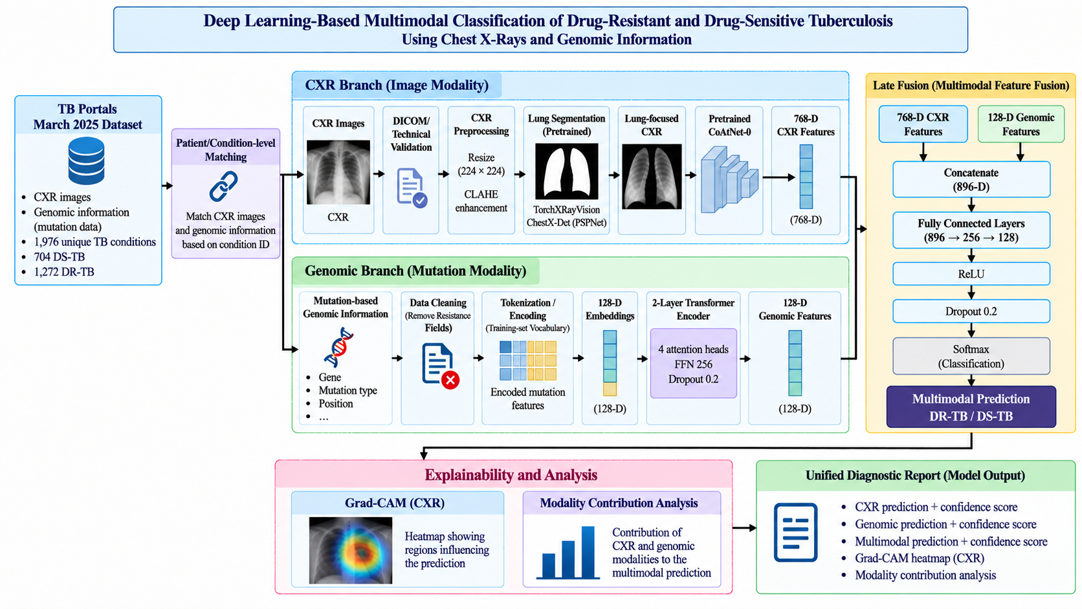
ARCHITECTURE DIAGRAM

Slide 7
PROPOSED WORK WITH PLANNED INNOVATION
Proposed Work
Isolate the lung region from the CXR and use CoAtNet-0 to classify DR-TB and DS-TB.
Use a Transformer to learn features from mutation-based genomic information.
Combine CXR and genomic features using late fusion for multimodal classification.
Use Grad-CAM and modality analysis to explain the model predictions.
Generate a diagnostic report with CXR, genomic, and multimodal predictions and their confidence scores.
Planned Innovation
Focus on the lung region before extracting CXR features.
Use CoAtNet-0 for CXR features and a Transformer for genomic features.
Combine the two modalities using late fusion.
Provide Explainable AI and confidence-based results in a unified report.

Slide 8
MODULES OF THE PROJECT
Module 1: Dataset Collection
Collected CXR images and genomic information from the TB Portals March 2025 dataset
Selected 1,976 unique TB conditions
Included 704 DS-TB conditions and 1,272 DR-TB conditions
Matched CXR images and genomic information with the corresponding TB condition
Collected mutation-based genomic information, including gene and mutation information
Module 2: CXR Image Preprocessing
Resized the collected CXR images to 224 × 224 pixels
Applied CLAHE (Contrast Limited Adaptive Histogram Equalization) to enhance the contrast of the CXR images

Slide 9
Module 3 : Lung Segmentation
Used the pretrained TorchXRayVision ChestX-Det PSPNet for lung-region segmentation
Generated lung-region probability maps from the preprocessed CXR images
Converted the probability maps into binary lung masks using a threshold
Combined the segmented lung regions to obtain the complete lung mask
Applied the lung mask to the CXR image to remove irrelevant non-lung regions
Obtained lung-focused CXR images for subsequent DR-TB and DS-TB classification
Module 4 : Dataset Preparation and Splitting
Organized the lung-focused CXR images according to their DR-TB and DS-TB labels
Kept the corresponding genomic information linked to the same TB condition
Used random seed 42 for reproducible dataset splitting
Training set 1,185 conditions — 422 DS-TB and 763 DR-TB
Validation set 395 conditions — 141 DS-TB and 254 DR-TB
Testing set 396 conditions — 141 DS-TB and 255 DR-TB

Slide 10
Module 5: CoAtNet-0 Model Training
Load the pretrained CoAtNet-0 (coatnet_0_rw_224) model.
Use the lung-focused CXR images with an input resolution of 224 × 224 pixels.
Replace the original classification head with a 2-class output layer for DS-TB and DR-TB.
Extract 768-dimensional feature representations from the CoAtNet-0 backbone.
Use class-weighted CrossEntropyLoss with label smoothing of 0.02.
Use the AdamW optimizer with a backbone learning rate of 1 × 10⁻⁵ and classifier learning rate of 1 × 10⁻⁴.
Set the weight decay to 1 × 10⁻⁴.
Use a batch size of 4 with gradient accumulation of 4 steps, giving an effective batch size of 16.
Apply gradient clipping with a maximum norm of 1.0.
Use a cosine annealing learning-rate schedule during training.
Train the model for a maximum of 40 epochs.
Validate the model after each epoch using the validation dataset.
Select and save the best model checkpoint based on validation ROC-AUC.

Slide 11
Module 6: Genomic Data Processing and Transformer
Processed the mutation-based genomic information associated with each TB condition
Represented the mutation information as a sequence of genomic tokens
Used a genomic vocabulary of 78 tokens
Limited the genomic sequence length to 74 tokens
Converted the tokens into 128-dimensional embeddings
Passed the embedded sequences through a 2-layer Transformer encoder
Used 4 attention heads and a 256-dimensional feed-forward layer
Applied 0.2 dropout during Transformer processing
Generated a 128-dimensional genomic feature representation
Used the genomic representation for DS-TB and DR-TB classification

Slide 12
Module 7: Multimodal CXR–Genomic Fusion
Use the 768-dimensional CXR features extracted from CoAtNet-0
Use the 128-dimensional genomic features extracted from the Transformer
Project the CXR features from 768 to 256 dimensions
Project the genomic features from 128 to 128 dimensions
Apply Batch Normalization to both modality representations
Concatenate the CXR and genomic features to form a 384-dimensional fused representation
Pass the fused representation through a 128-dimensional fully connected layer with ReLU activation
Apply 0.2 dropout to the fused representation
Use a final 2-class output layer for DS-TB and DR-TB classification
Train the fusion network using Adam optimizer with a learning rate of 0.001
Generate the final multimodal DR-TB and DS-TB prediction from the fused CXR and genomic features

Slide 13
Module 8: Explainable AI and Unified Diagnostic Report
Apply Grad-CAM to the trained CoAtNet-0 model to identify the CXR regions influencing the DR-TB and DS-TB prediction
Generate Grad-CAM heatmaps for the test cases
Perform modality-contribution analysis to determine the contribution of CXR and genomic information to the multimodal prediction
Generate the CXR-based prediction and confidence score
Generate the genomic-based prediction and confidence score
Generate the multimodal prediction and confidence score
Present the Grad-CAM heatmap and modality-contribution results along with the three model predictions
Combine these results into a unified diagnostic report for interpretation

Slide 14
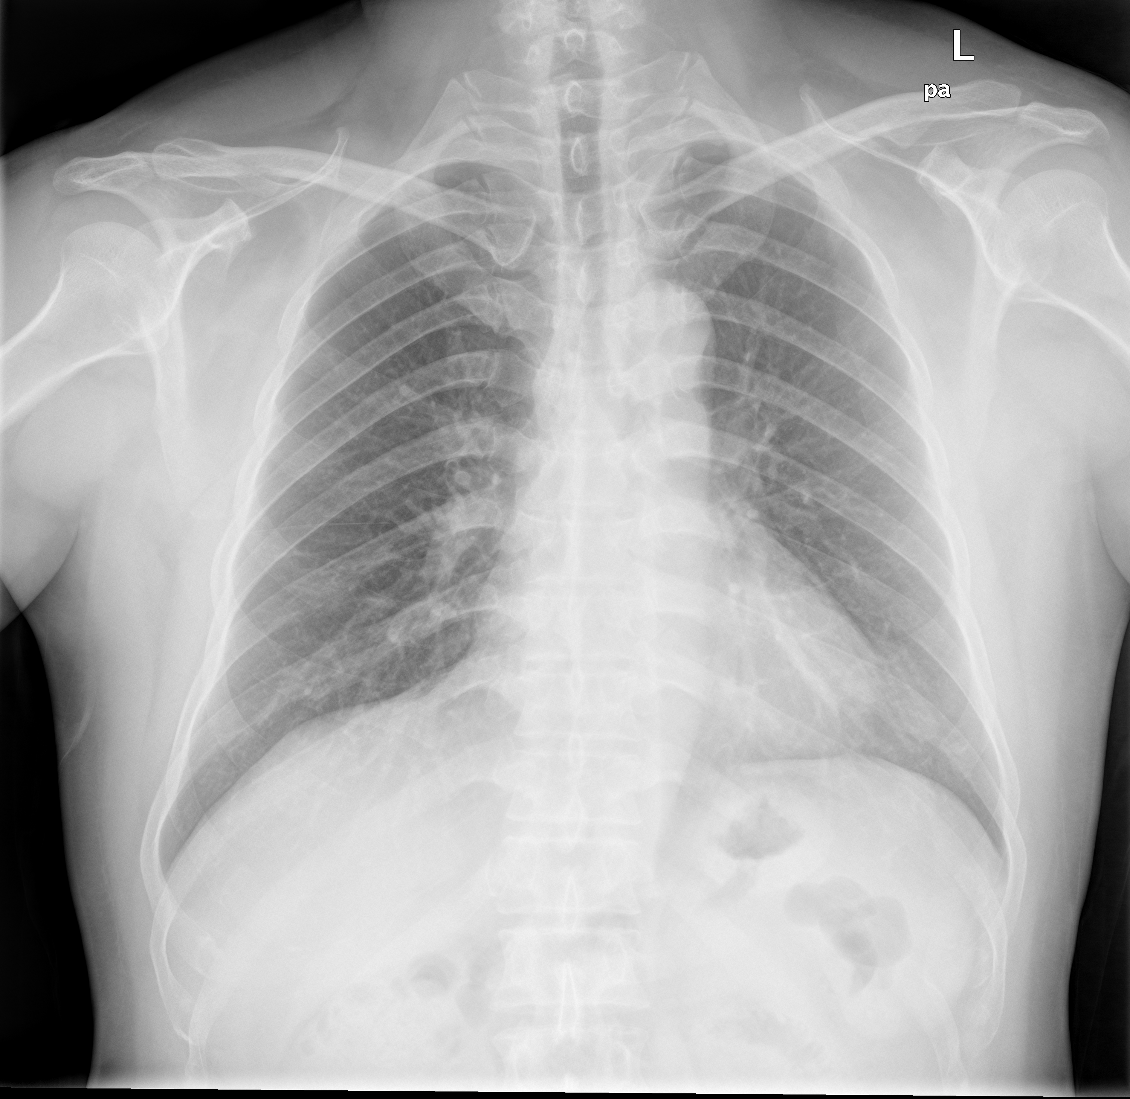
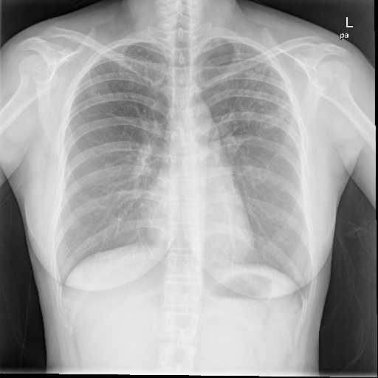
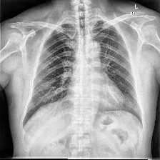
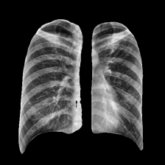
IMPLEMENTATION
Original Image Resized (224 × 224) Image CLAHE Enhanced Image(224×224) Segmented Lung Image(224×224)

Slide 15
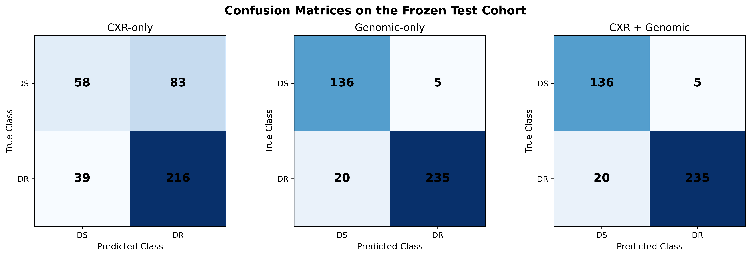

Slide 16

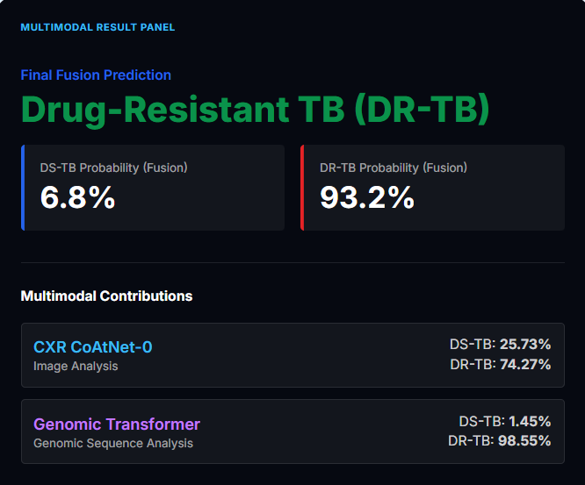
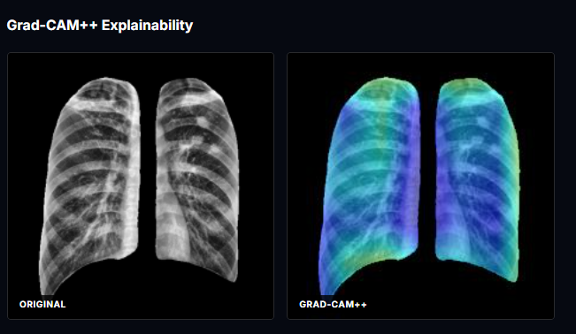

Slide 17
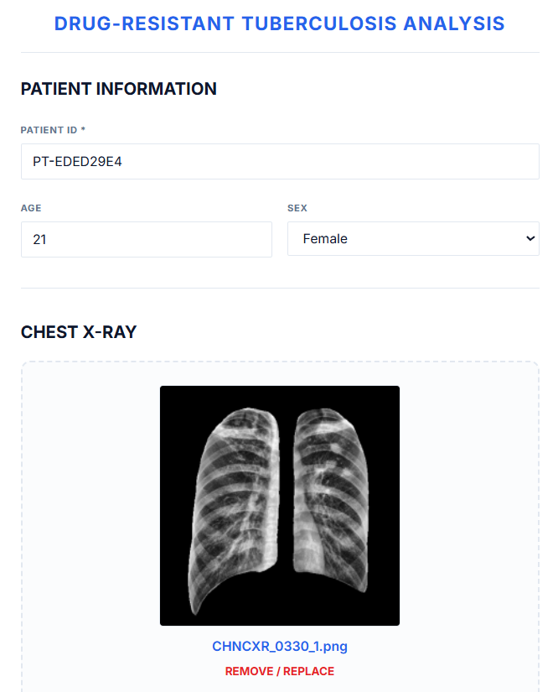
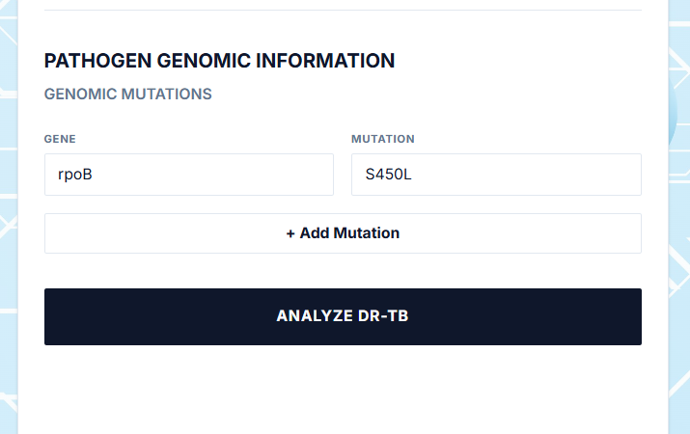

Slide 18
BASE LINE COMPARISION
Feature / Component | Baseline System | Proposed System
Input | Chest X-ray | Chest X-ray + Genomic Information
CXR Model | DEiT-B/16 | CoAtNet-0
Genomic Model | Not used | Transformer
Fusion | Not used | Late Fusion
Classification | DR-TB vs DS-TB | DR-TB vs DS-TB
Precision | 0.826 | 97.92%
Recall / Sensitivity | 0.828 | 92.16%
F1-Score | 0.827 | 94.95%
ROC-AUC | 0.800 | 0.9714
Accuracy | 86% | 93.69%
Interpretability | Local feature-based explanation | Class-specific visual explanation
Diagnostic Support | Limited | Enhanced with visual and structured reporting
Diagnostic Support | Limited | Enhanced with visual and structured reporting

Slide 19
EXISTING SYSTEM COMPARISON
Feature / Component | Existing System | Proposed System
Dataset | TB Portals | TB Portals March 2025
Input | Radiological findings + genomic features | Chest X-ray images + mutation-based genomic information
Lung Segmentation | Not used as a model stage | Pretrained ChestX-Det PSPNet
CXR Model | No deep CXR model; radiological features used | CoAtNet-0
Genomic Model | Conventional machine-learning features | Transformer
Classification Model | Random Forest | Multimodal late-fusion network
Accuracy | 92.4% ± 0.8% | 93.69%
ROC-AUC | 0.957 ± 0.005 | 0.9714
Explainability | No integrated XAI pipeline reported | Grad-CAM + modality-contribution analysis
Unified Diagnostic Report | Not reported | Prediction, confidence scores and explainability outputs
Diagnostic Support | Limited | Enhanced with visual and structured reporting

Slide 20
COMPLEXITY & COST
Aspect | Proposed System
Computational Complexity | Uses lung segmentation, CoAtNet-0, genomic Transformer, and multimodal fusion, resulting in higher computational requirements during training.
Implementation Complexity | Involves multiple stages including CXR preprocessing, lung segmentation, CXR classification, genomic processing, multimodal fusion, explainability, and report generation.
Hardware Cost | Model training may require GPU resources due to CoAtNet-0, Transformer processing, and multimodal training.
Development Cost | Uses open-source deep learning frameworks and pretrained models such as CoAtNet-0 and TorchXRayVision, reducing software and licensing costs.
Operational Cost | After training, the system can automate CXR, genomic, and multimodal predictions with explainability, reducing repeated manual analysis.

Slide 21
RELEVANCE TO ENVIRONMENT & SUSTAINABILITY
Relevance to Environment
Supports paperless digital diagnosis using CXR and genomic information.
Reduces the need for repeated physical diagnostic procedures by utilizing existing digital patient data.
Sustainability
Provides a scalable AI-based approach for DR-TB and DS-TB classification.
Reuses existing CXR and genomic datasets for automated analysis.
Supports efficient analysis of large numbers of TB cases through automated multimodal processing.
SDG Goal Mapping
SDG 3 – Good Health and Well-being
The proposed AI-based system combines CXR and genomic information to classify Drug-Resistant and Drug-Sensitive Tuberculosis, supporting improved diagnostic assessment and healthcare decision-making.

Slide 22
REFERENCES
A. Mnyambo et al. (2026). Explainable AI for Drug-Resistant Tuberculosis Detection from Chest X-Rays: Multi-Level Interpretability and Cross-Dataset Transfer Learning. Biomedical Signal Processing and Control, 126:110989.
A. Mnyambo et al. (2026). Multimodal Approaches for Tuberculosis Drug-Resistance Analysis.
J. P. Cohen et al. (2021). TorchXRayVision: A Library of Chest X-Ray Datasets and Models.
Z. Dai, H. Liu, Q. V. Le, and M. Tan (2021). CoAtNet: Marrying Convolution and Attention for All Data Sizes. Advances in Neural Information Processing Systems.
A. Dosovitskiy et al. (2021). An Image is Worth 16×16 Words: Transformers for Image Recognition at Scale. International Conference on Learning Representations.
E. Showkatian et al. (2022). Deep Learning-Based Automatic Detection of Tuberculosis Disease in Chest X-Ray Images. Polish Journal of Radiology.

Slide 23
THANK YOU

